Slide 1
Data Mining 2 Supervised Learning
CLASSIFICATION 1
Dr. Shailesh Kumar
ISB/CBA

Slide 2
From Data to Decisions…
Insights
Features
Domain Knowledge
Models
Data
Predictions
Decision
Business Objectives
Business Constraints
Feedback

Slide 3
Clustering vs. Classification

Slide 4
Clustering Problems
Types of pages are there on the Web?
Types of customers are there in my market?
Types of people are there on a Social network?
Types of E-mails in my Inbox?
Types of Genes the human genome has?
Types of Stars/Planets/Galaxies are in the Universe?
Types of Songs/Movies in my Audio Library?
Types of animals/plants are there on Earth?

Slide 5
Classification Problems
Credit card transaction → {Fraud, Not Fraud}
Credit history → {Approve, Not Approve}
News Article → {Sports, Entertainment, Politics, Science, …}
Web Page → {Spam, Not Spam}
E-Mail → {Important, Promotion, Social, Spam}
E-Mail → {Issue-1, Issue-2, Issue-3, …}
Remote Sensing → {Water, Marsh, Rock, Crop, Sand}
Radio Signal → {Supernova, White Dwarf, Red Giant, …}

Slide 6
Descriptive vs. Discriminative

Slide 7
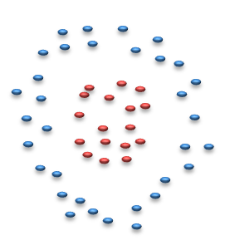
Two types of Classifier Paradigms
Descriptive Classifiers
Bayesian Classifiers
Nearest Neighbor
Parzen Window
Discriminative Classifiers
Decision Trees
Neural Networks,
Support Vector Machines

Slide 8
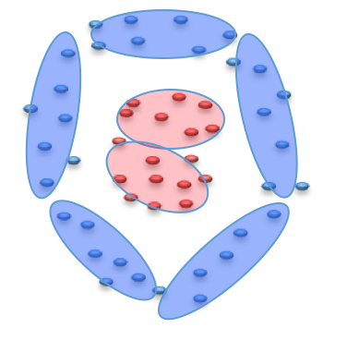
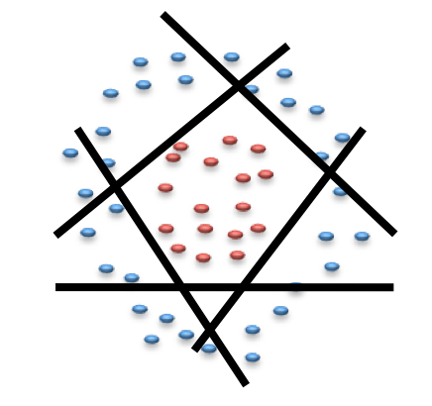
Descriptive Classifiers
Discriminative Classifiers

Slide 9
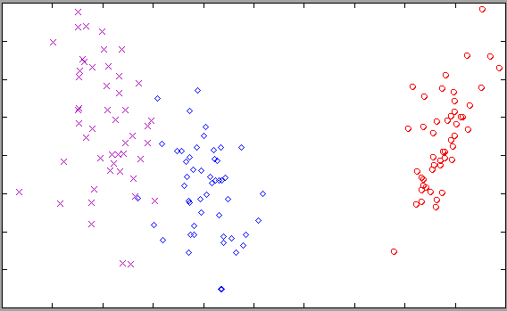
IRIS – Descriptive Classifier

Slide 10
IRIS – Discriminative Classifier

Slide 11
What is “Classification”?
PARTITIONING the (FEATURE) SPACE into PURE REGIONS assigned to each CLASS

Slide 12
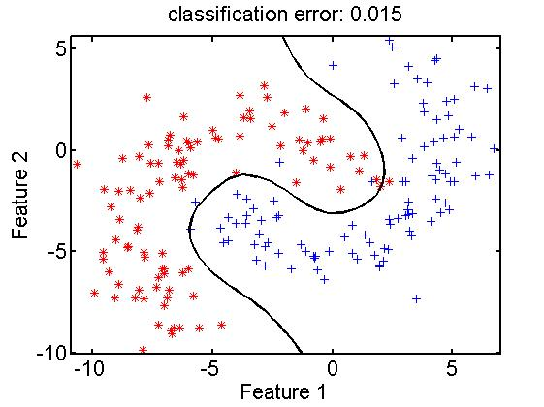
Partitioning into Pure Region
Purity
Region - 1
Decision Boundary
Region - 2
Transformation

Slide 13
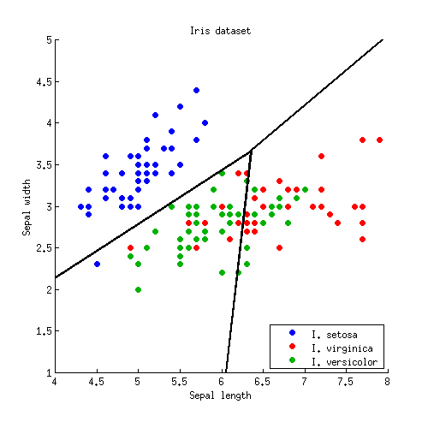
Decision Boundary for IRIS data

Slide 14
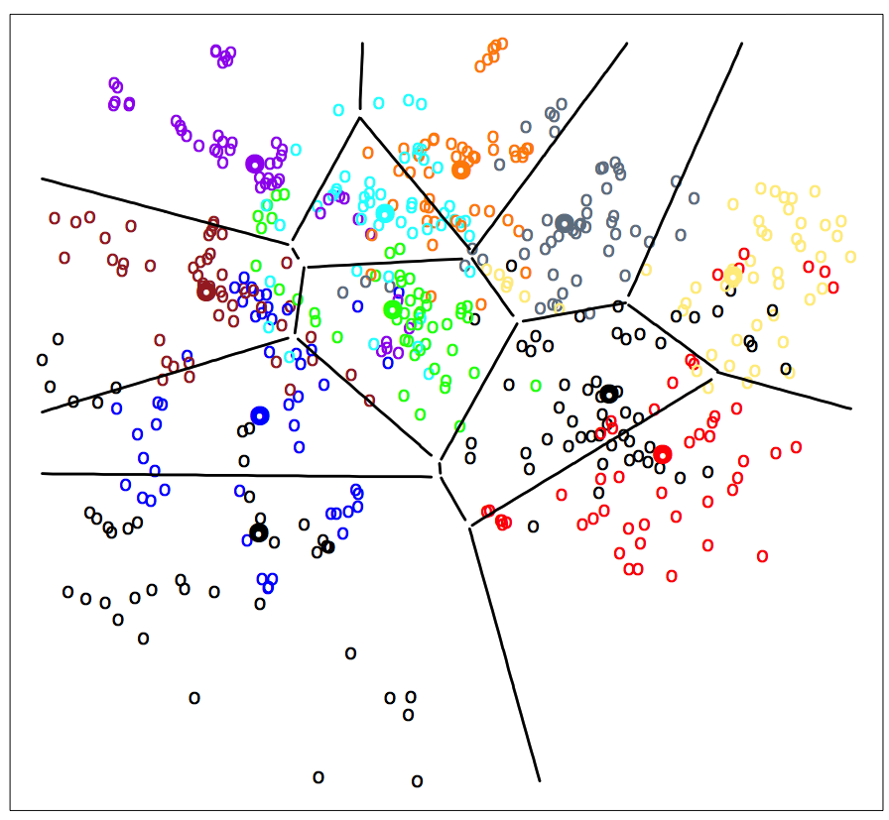
Decision Boundaries for DIGITS data

Slide 15
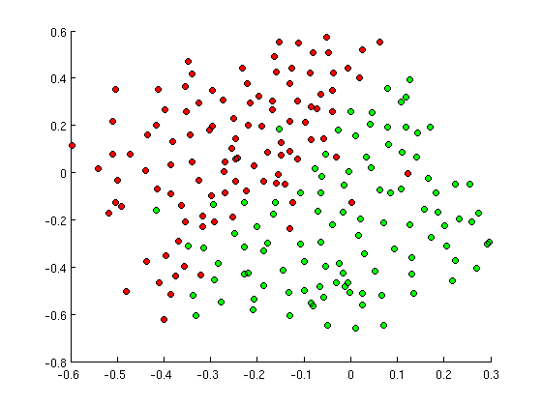
SIMPLE Decision Boundary?

Slide 16
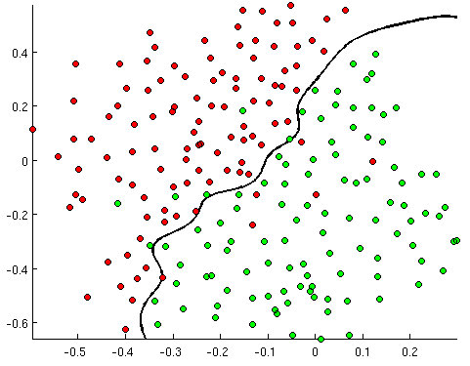
MEDIUM Decision Boundary!

Slide 17
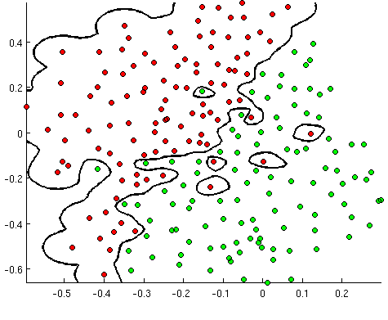
COMPLEX Decision Boundary!

Slide 18
Model SIGNAL not NOISE
Model is too simple → UNDER LEARN
Model is too complex → MEMORIZE
Model is just right → GENERALIZE

Slide 19

What is Intelligence?
Generalization: Ability to predict or assign a label to a “new” observation based on the model built from past experience

Slide 20
Generalize, don’t Memorize!
Training Set Accuracy
Right Level of Model Complexity
Model Accuracy
Validation Set Accuracy
Model Complexity

Slide 21
Questions for Classification!
What is the NATURE of classifier’s DECISION BOUNDARY?
Depends on the classifier type!
What is the COMPLEXITY of classifier’s DECISION BOUNDARY?
Any classifier can be made more or less complex!
How do I CONTROL the COMPLEXITY of the classifier?
What knob to use to make classifier more / less complex?
How do I know when the classifier is COMPLEX ENOUGH?
Degree of Noise vs. Structure in the data
Too noisy → Less complexity
How to pick the right CLASSIFIER to use?
Nature of the data - structure/unstructured, numeric/categorical
Complexity of the decision surface needed!

Slide 22
Rule based Classifiers

Slide 23
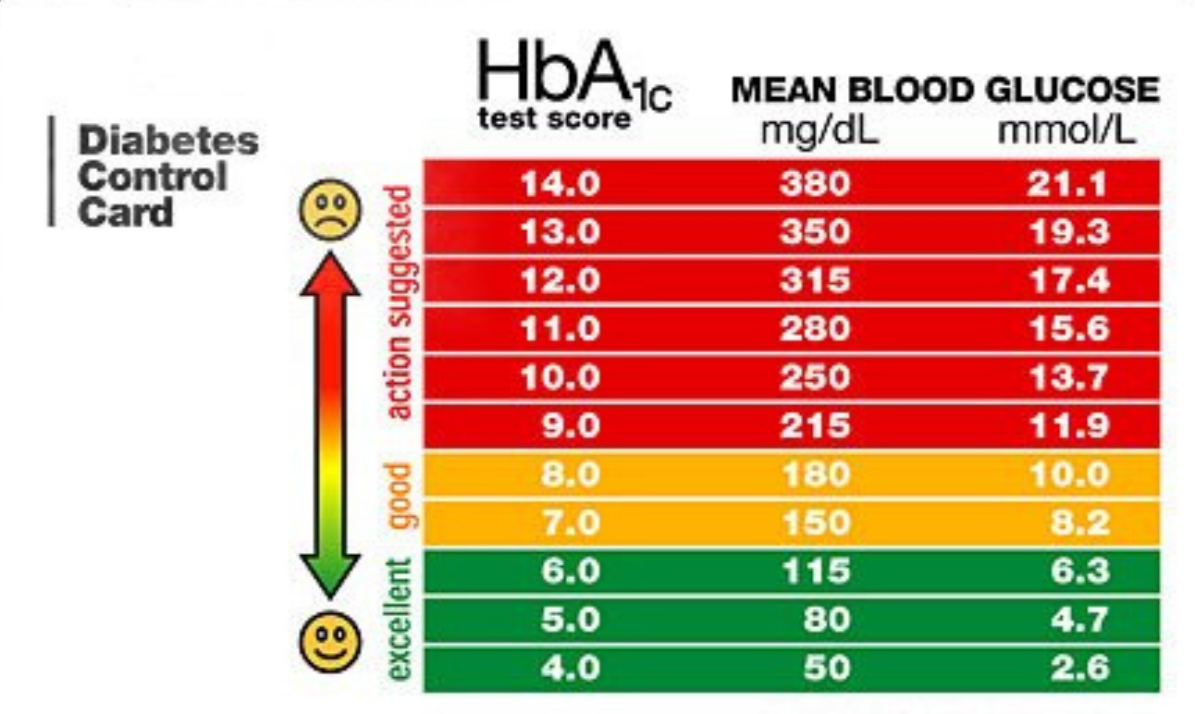
Domain Knowledge based
Fever Rules
If TEMP <= 98.6 → NORMAL
If TEMP <= 100.0 → MILD-FEVER
If TEMP < 102.0 → MEDIUM-FEVER
If TEMP > 104.0 → HIGH-FEVER

Slide 24
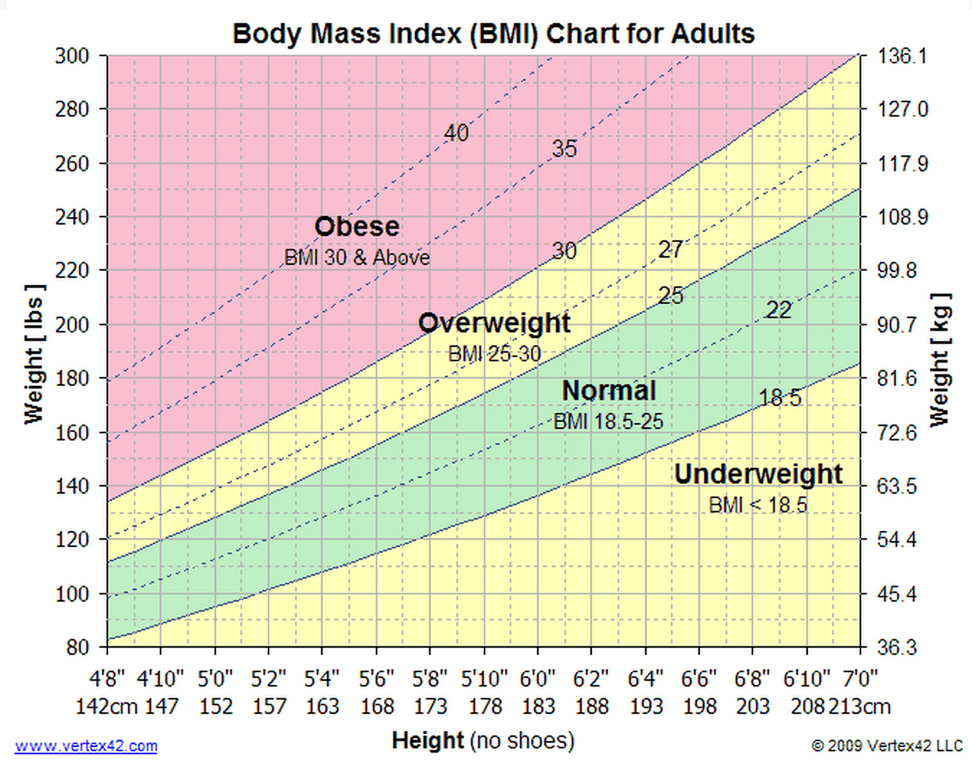
Obesity Classifier
Height
Feature Engineering
Model
Obesity
Level
BMI
Weight
Engineered Feature based on Domain Knowledge

Slide 25
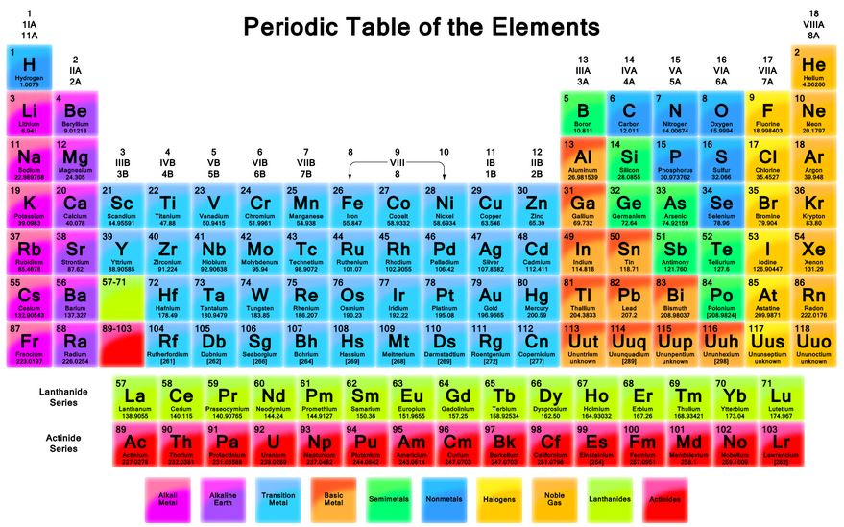
Elements Classifier

Slide 26
Decision Trees Learning Rules from Data

Slide 27
“Toy” Dataset
Consider a dataset of toys given by three attributes:
COLOR = {Red, Green, Blue},
SHAPE = {Square, Circle, Triangle}, and
LIKE = {Yes, No} of whether a kid likes the toy or not.
#EXAMPLES | COLOR | SHAPE | LIKE = Y | LIKE = N
30 | Red | Square | 15 | 15
10 | Red | Circle | 0 | 10
20 | Red | Triangle | 15 | 5
10 | Green | Square | 10 | 0
30 | Green | Circle | 20 | 10
10 | Green | Triangle | 5 | 5
20 | Blue | Square | 5 | 15
20 | Blue | Circle | 15 | 5
30 | Blue | Triangle | 30 | 0

Slide 28
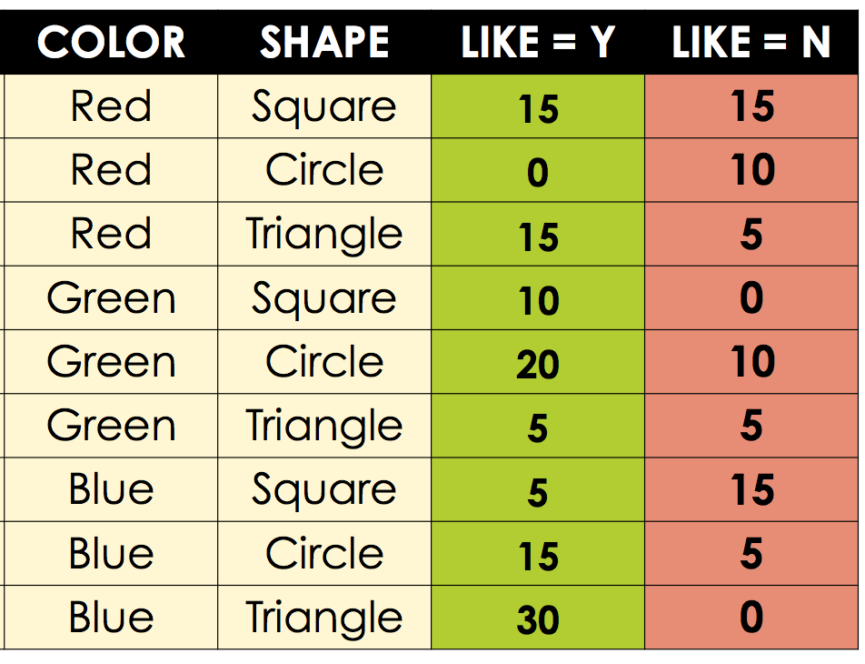
Partitioning the Categorical Space?
 |  | COLOR
 |  | Red | Blue | Green
SHAPE | Circle
 | Square
 | Triangle

Slide 29
Joint and Marginal Probability
 |  | COLOR
 |  | Red | Blue | Green | TOTAL
SHAPE | Circle | 10 | 20 | 30 | 60
 | Square | 30 | 20 | 10 | 60
 | Triangle | 20 | 30 | 10 | 60
 | TOTAL | 60 | 70 | 50 | 180

Slide 30
Conditional Probability
 |  | COLOR
 |  | Red | Blue | Green | TOTAL
SHAPE | Circle | 10 | 20 | 30 | 60
 | Square | 30 | 20 | 10 | 60
 | Triangle | 20 | 30 | 10 | 60
 | TOTAL | 60 | 70 | 50 | 180
70
20
60
COLOR = Blue
SHAPE = Square

Slide 31
Conditional Probability Distribution
 |  | COLOR
 |  | Red | Blue | Green | TOTAL
SHAPE | Circle | 10 | 20 | 30 | 60
 | Square | 30 | 20 | 10 | 60
 | Triangle | 20 | 30 | 10 | 60
 | TOTAL | 60 | 70 | 50 | 180

Slide 32
Class distribution of a region!
 |  | COLOR
 |  | Red | Blue | Green | TOTAL
SHAPE | Circle | 0 / 10 | 15 / 5 | 20 / 10 | 60
 | Square | 15 / 15 | 5 / 15 | 10 / 0 | 60
 | Triangle | 15 / 5 | 30 / 0 | 5 / 5 | 60
 | TOTAL | 60 | 70 | 50 | 180

Slide 33
Exponential Growth in Cells
 |  | COLOR
 |  | Red | Blue | Green | TOTAL
SHAPE | Circle | 0 / 10 | 15 / 5 | 20 / 10 | 60
 | Square | 15 / 15 | 5 / 15 | 10 / 0 | 60
 | Triangle | 15 / 5 | 30 / 0 | 5 / 5 | 60
 | TOTAL | 60 | 70 | 50 | 180
Number of CELLS in this table = ??
As this grows, number of cells grows!

Slide 34
Purity = ACCURACY
R(Cir, ?)
5 / 60
R(Sqr, ?)
40 / 40
R(Tri, ?)
60 / 10
LABEL??
Accuracy = ??
Accuracy = ??
Accuracy = ??
LABEL??
R(?, Red)
35 / 30
R(?, Blu)
45/ 35
R(?, Gre)
25/ 45

Slide 35
Purity = ACCURACY
Each PARTITION has data points from EVERY class.
Size of the PARTITON = total number of data points in it.
Each PARTITION has a CLASS PROBABILTY DISTRIBUTION.
Each PARTITION is assigned its MAJORITY CLASS LABEL
ACCURACY = fraction of CORRECTLY labeled examples
ERROR = fraction of INCORRECTLY labeled examples

Slide 36
Purity = GINI Measure
In ACCURACY we assign the DOMINANT LABEL to each region
We now assign PROBABILISTIC LABEL to each region
R(Cir, ?)
5 / 60
R(Sqr, ?)
40 / 40
R(Tri, ?)
60 / 10
DOMINANT LABEL
5/65
40/80
60/70
PROBABILISTIC LABEL
60/65
40/80
10/70

Slide 37
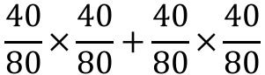
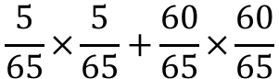
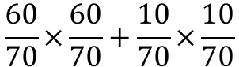
Purity = GINI Measure
EXPECTED ACCURACY with PROBABISTIC LABELING
R(Cir, ?)
5 / 60
R(Sqr, ?)
40 / 40
R(Tri, ?)
60 / 10
5/65
40/80
60/70
PROBABILISTIC LABEL
60/65
40/80
10/70
$$\frac{5}{65}×\frac{5}{65}+\frac{60}{65}×\frac{60}{65}$$
$$\frac{40}{80}×\frac{40}{80}+\frac{40}{80}×\frac{40}{80}$$
$$\frac{60}{70}×\frac{60}{70}+\frac{10}{70}×\frac{10}{70}$$

Slide 38
Purity = GINI Measure
Each PARTITION has data points from EVERY class.
Size of the PARTITON = total number of data points in it.
Each PARTITION has a CLASS PROBABILTY DISTRIBUTION.
GINI measures the EXPECTED ACCURACY of the PARTITION

Slide 39
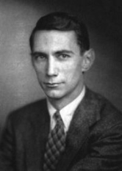
Information Theory 101
What is the “Information Content” of the following events?
The sun rose in the east today.
The weather in London is Cloudy.
A baby is born in my community.
A major earthquake hit LA.
The Information Content is proportional to RARITY.
Claude Elwood Shannon (1916–2001)

Slide 40
Entropy of a Distribution
Consider a UNIVERSE of possible events (dice = {1, 2, …, 6})
Probability of an event:
Number of bits to transmit that event:
Expected Number of bits for all events?
The Entropy is the Expected Information Content of all events

Slide 41
Purity = INFORMATION CONTENT
Each PARTITION has data points from EVERY class.
Size of the PARTITON = total number of data points in it.
Each PARTITION has a CLASS PROBABILTY DISTRIBUTION.
ENTROPY is the INFORMATION CONTENT of the PARTITION

Slide 42
2-Class Purity/Impurity measures

Slide 43
Partition this!
 | Red | Blue | Green | TOTAL
Circle | 0 / 10 | 5 / 20 | 0 / 30 | 5 / 60
Square | 15 / 15 | 10 / 15 | 15 / 10 | 40 / 40
Triangle | 20 / 5 | 30 / 0 | 10 / 5 | 60 / 10
TOTAL | 35 / 30 | 45 / 35 | 25 / 45 | 105 / 110
R(?, ?)
105 / 110
R(Cir, ?)
5 / 60
R(Sqr, ?)
40 / 40
R(Tri, ?)
60 / 10
R(?, ?)
105 / 110
Which is a “better” partition?
What is “purity” of a partition?
R(?, Red)
35 / 30
R(?, Blu)
45/ 35
R(?, Gre)
25/ 45

Slide 44
Information Gain
R(?, ?)
105 / 110
R(Cir, ?)
5 / 60
R(Sqr, ?)
40 / 40
R(Tri, ?)
60 / 10
R(?, ?)
105 / 110
R(?, Red)
35 / 30
R(?, Blu)
45/ 35
R(?, Gre)
25/ 45

Slide 45
Which feature to pick first?
R(?, ?)
105 / 110
R(Cir, ?)
5 / 60
R(Sqr, ?)
40 / 40
R(Tri, ?)
60 / 10
R(?, ?)
105 / 110
R(?, Red)
35 / 30
R(?, Blu)
45/ 35
R(?, Gre)
25/ 45

Slide 46
GREEDY Decision Tree Algorithm
A
a1
a2
a3
C
E
B
c1
c2
e1
e2
e3
b1
b2
b3
E
B
C
e1
e2
e3
b1
b2
b3
c1
c2

Slide 47
Rules for LEAF nodes
A
a1
a2
a3
C
E
B
c1
c2
e1
e2
e3
b1
b2
b3
A=a1 ^ C = c1
E
B
C
e1
e2
e3
b1
b2
b3
c1
c2
A=a2 ^ E = e3 ^ B = b2

Slide 48
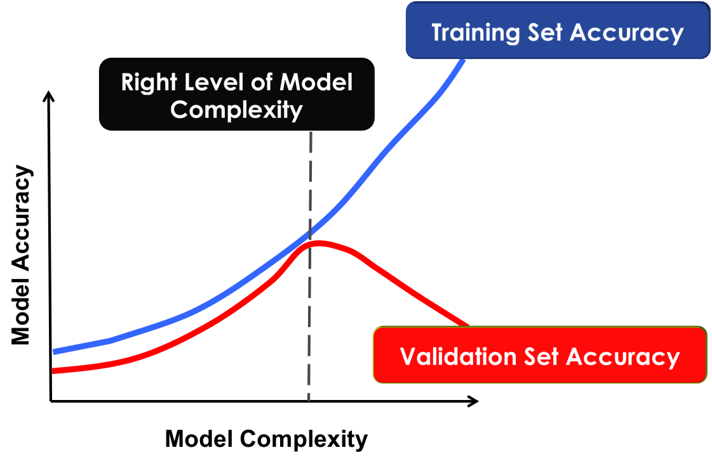
Controlling COMPLEXITY

Slide 49
OVERFITTING
A
a1
a2
a3
C
E
B
c1
c2
e1
e2
e3
b1
b2
b3
E
B
C
e1
e2
e3
b1
b2
b3
c1
c2

Slide 50
PRUNNING
A
a1
a2
a3
C
E
B
c1
c2
e1
e2
e3
b1
b2
b3
C
c1
c2

Slide 51
Numeric Attributes
A
a1
a2
a3
C
X < t1
B
c1
c2
X1
X2
b1
b2
b3
C
A = a2
c1
c2

Slide 52
Feature engineering in DT’s
Age < 60
log (Income) - B x Age < 12
Income < Rs. 32
Education < 20
Education < 20
Income
?
log (Income)
Age
Age

